Slide 1
Russia
Macro & Business Outlook 2018
February 2018
Christopher J. Weafer
cjw@macro-advisory.com
1
Notes:
1

Slide 2
Macro & Business Trends
Low growth but stable economy in 2018 & 2019. But economy needs investment to grow faster after 2020
Government is more likely to retain a conservative budget bias but is likely to spend “extra” oil revenues in 2019 & 2020, if oil averages above $60 p/bbl (Urals)
High oil price eases pressure for tax reforms
So far, no indications that White House or Kremlin wants to escalate sanctions. The Kremlin is sticking with it’s mantra of “bad politics should not damage good business”
Medvedev may stay as PM but expected significant changes in government, in state agencies and in some state enterprises
Putin’s priority will be to maintain stability and prepare for 2024

Slide 3
2017 Results - GDP
Growth peaked in 2Q17…economy may technically have returned to recession in 4Q17
Full year 2017 growth may be between 1.4% - 1.7%
The strongest contributor to growth was agriculture and state spending via budget projects

Slide 4
2017 Results – Inflation
Headline inflation fell to 2.5% YoY by year end
Food inflation was better, ending at less than 1.0%
But Producer Inflation (PPI) went in the opposite direction and ended above 8% YoY

Slide 5
Russia Forecasts: 2018-2020
Sanctions and oil may have an impact this year
Growth should stay positive, but modest
Growth will be restrained because of the need for infrastructure spending and efficiency improvements
Inflation will rise in 2018, but should end less than 4.0%

Slide 6
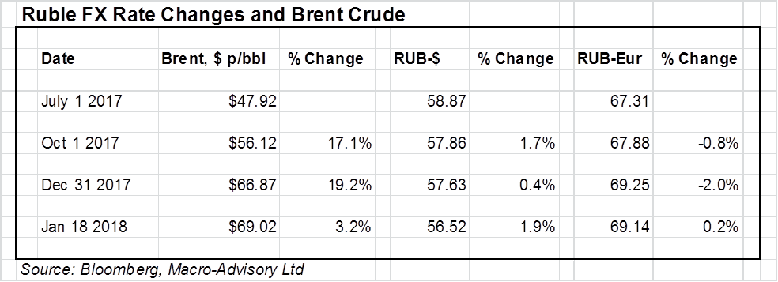
Ruble Outlook
Ruble has stayed steady vs the Euro even as oil rallied
Ruble-US$ appreciation is due to US$ decline
Government remains firm in the view that weak ruble is part of core policy
Budget Rule should weaken ruble in March/April…government is sticking with a target of 60 v the $ by year-end

Slide 7
Ruble $ and Euro Divergence
Ruble has only recently strengthen v the US dollar as the oil rally continues…
….but this is more because of the dollar weakness than ruble strength

Slide 8
Budget Assumptions
Budget is based on $41 p/bbl (Urals) for 2018, rising to $42 p/bbl in 2019 and $43 p/bbl for 2019
Budget rule will see all extra oil tax revenue (above the price assumption) go to the National Fund rather than be spent
Every $10 p/bbl above the assumption is worth approx. $22 bln to the Federal Budget
The budget would break even at approx. $58 p/bbl in 2018
At $70 /bbl (average) the budget would run a surplus of over $20 bln in 2018
It means there should be less pressure for tax reforms (higher taxes) and a probability of some extra spending in the autumn

Slide 9
Sanctions
2014 sanctions (both Western & Russian) have actually helped the economy survive lower oil
Sanctions have led to:
  Budget Plan
  Localization strategy
  Greater awareness of the need for changes
US Treasury reports (241 & 242) have been published
  Questions over classified report
  How will the list be enforced, if at all
But, for now, Kremlin Administration is sticking with “bad politics remains separate from good business” while the White House has shown little interest in escalation

Slide 10
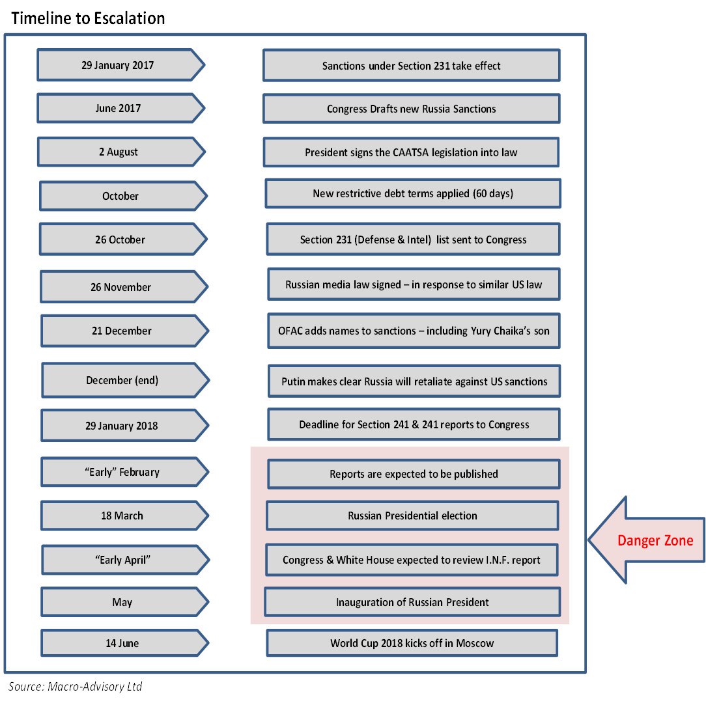
Dangerous Timeline

Slide 11
Politics
Putin’s Federal Assembly Address on February 6th
Main question about March 18th election is turnout, albeit the government “apparatus” should ensure a high level
Seems very likely that Medvedev will remain PM…
… but significant number of government changes are expected between March 18th and mid-May
Changes at senior level in State enterprises also expected
Putin’s may priority will be to maintain stability and, critically, create the right conditions for him to remain influential after March 2024

Slide 12
Localization Target Sectors
Agriculture & Food processing
Pharmaceuticals & Healthcare
I.T. and Technologies
Auto manufacturing & Parts supply
Machine building
Defence sector industries
Oil field services
Value-Added processing in oil, gas and extractive industries

Slide 13
Other Growth Sectors
Logistics, Transport & Warehousing
E-Commerce
Financial Services
Housing, especially starter-homes & affordable housing
Leisure sectors, including hotels, resorts & hospitality
Business services, including offices
Services linked to Belt & Road/ NSTC expansion
Health services and Education

Slide 14
Can a New Way Work?
Critically depends on success in;
  maintaining stable & predictable macro environment
  attracting investment into diversification industries
  diversifying exports away from extractive industries
  keeping competitive economic conditions
  dealing with the inevitable decline in available workforce
  making the budget more efficient
  Tax & administrative reforms
  adapting to any additional sanctions
  maintaining domestic stability & boosting household spending

Slide 15
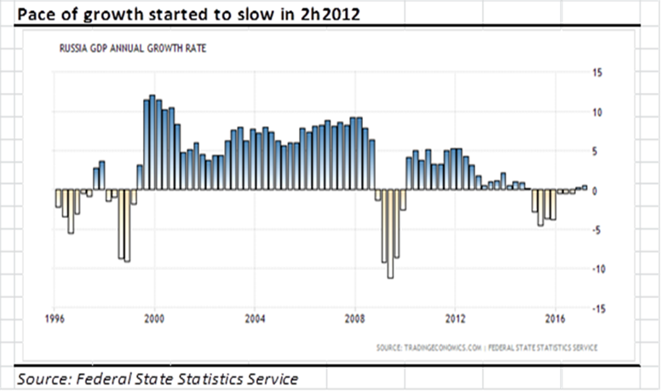
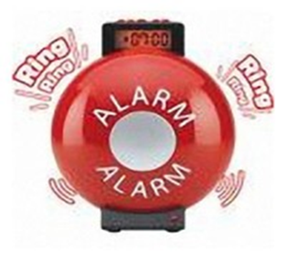
Why now?
Warning signs that the “hydrocarbon model” was becoming less effective appeared from late 2012
Events since 2014 have helped enforce the need for diversification in activity and exports
Public opinion matters a great deal … and polls show people want to see economic recovery in the next three years

Slide 16
Investor Concerns
Perception of Russia is very poor and will likely get worse before improving. This adds reputational risk to investment in Russia
How will the deterioration in labour demographics be dealt with?
Can the imbalance in the size of the state versus SMEs in the economy be addressed?
Will the inefficiencies of budget spending be rectified?
Will there be more money for education and research & development?
Pensions reform is urgent
Can Russia create a more meaningful pool of domestic capital to fund start-ups and longer-term projects?

Slide 17
Plenty of Positives
Russia is still in a relatively good position today
  Sixth lowest level of national debt and sixth highest financial reserves in the world
  Biggest population in Europe and with the highest per capita spending power & household wealth amongst developing nations (OECD data)
  Ranked sixth biggest world economy on PPP basis ($4 trillion) by IMF
  World’s biggest supplier of “extracted materials”, including oil (crude + products) and gas
  Attracted 2nd highest volume of FDI within Europe in 2016 (jointly with France and just below UK)

Slide 18
Eurasian Economic Union
Russia now holds the Presidency
Moscow and Astana expect more positive momentum in 2018 … previous distractions are over
Kazakhstan inaugurated the International Financial Center in Astana on January 1st
Removing trade blockages and customs delays are expected to be a priority
China’s Belt & Road is expanding across the region

Slide 19
INDEPENDENT ♦ LOCAL ♦ ACTIONABLE
We are totally independent, and pride ourselves on providing completely objective analysis without any political bias or financial agenda
From our base in the region, Macro-Advisory cuts through the noise to help investors better understand how to navigate and monetize opportunities in Eurasia
We take great pride in providing actionable and commercial advice based on the most thorough analysis of primary sourced business intelligence

Slide 20
Contacts
Macro-Advisory provides a bespoke macro consulting service for companies and investors working in Russia and other countries across the C.I.S. and Eurasia region
Our service options include access to regular published reports, special project work, on-site presentations and other bespoke work.
For further information, contact us at info@macro-advisory.com
Our web site is www.macro-advisory.com
No warranties, promises, and/or representations of any kind, expressed or implied are given as to the nature, standard, accuracy, or likewise of the information provided in this material nor to the suitability or otherwise of the information to your particular circumstances. Macro-Advisory Limited does not accept any responsibility or liability for the accuracy, content, completeness, legality, or reliability of the content contained in this note. © Copyright Macro-Advisory Limited
Notes:
20
20

